Slide 1

WHO WE ARE
HRG began during the Syrian refugee crisis in 2016 as an all-volunteer, grassroots organization formed by a group of like-minded individuals who saw a need in the community. We started by providing support services to newly arrived refugees.
HRG has evolved into a multilingual, multicultural non-profit organization with a staff of former volunteers, refugees and immigrants, dedicated to serving refugees, immigrants & vulnerable populations in a respectful, culturally sensitive manner.

Slide 2
OUR
MISSION
Hanan Relief Group is one of the nation’s leading relief organizations that empowers vulnerable communities, here and around the world. We provide indispensable tools and support to help
individuals & families become
independent, valued and contributing members of society.

Slide 3
OUR
VISION
A world where every refugee and vulnerable individual anywhere
is empowered to thrive, contribute, and build a future of dignity
and hope within a supportive community.

Slide 4
OUR PILLARS
Compassion
We believe in dignity, humanity and building trust
Investment
Our daily work directly contributes to improving the economic and social status of the
communities we serve
Impact
Our clients have built businesses, created jobs, and are active contributors to our economy
and communities

Slide 5
Sheila Badwan, Executive Director
Umalkhayr Abdi, Refugee Programs Director
Sausan Naji, Operations/HR manager
Abid Kazmi, Finance Manager
Fatin Miqbel- Finance & Legal Coordinator
Desire Mukucha, Lead Case Manager
Lena Mahmoud, Case Aide
Sakinah Salim,Administrative Assistant
Helima Aichoune, Volunteer & Donations Coordinator
Sarah Mankowski-Lathrum, ESL Coordinator
Amal Azzam, Community Events & Social Media Coordinator
Emma Garriott, Global Executive Coordinator
Maryam Durani, Cultural Programs Manager
Dema Hamed, Triumph Health Intern
Michelle Lin- Triumph Health Intern
Barrett MCCormick, Accredited Representative
Zachariya Schaub, Administrative Assistant
Omar Abdi, IT
OUR TEAM

Slide 6
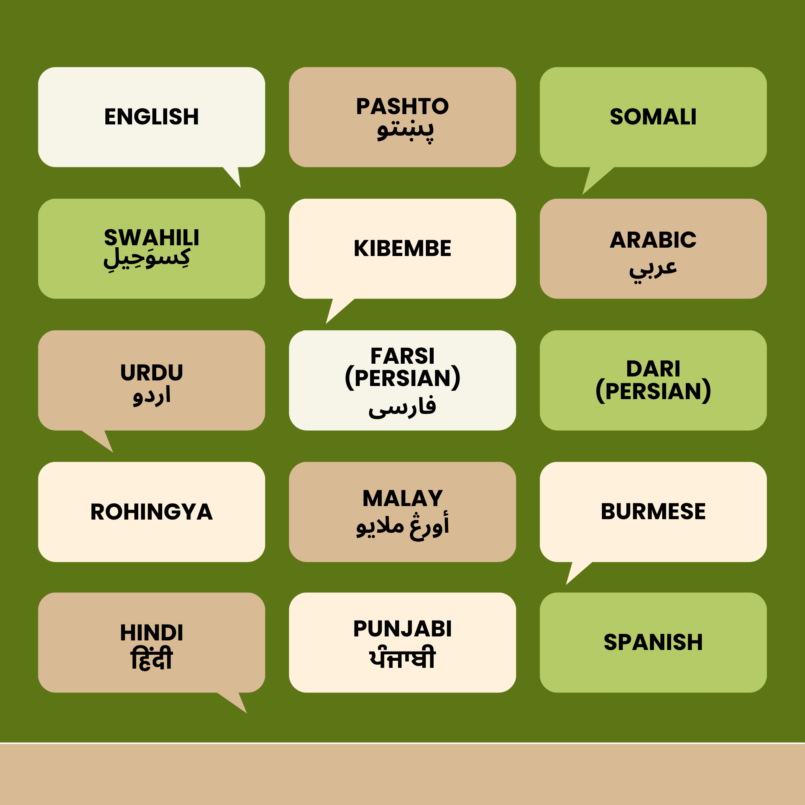
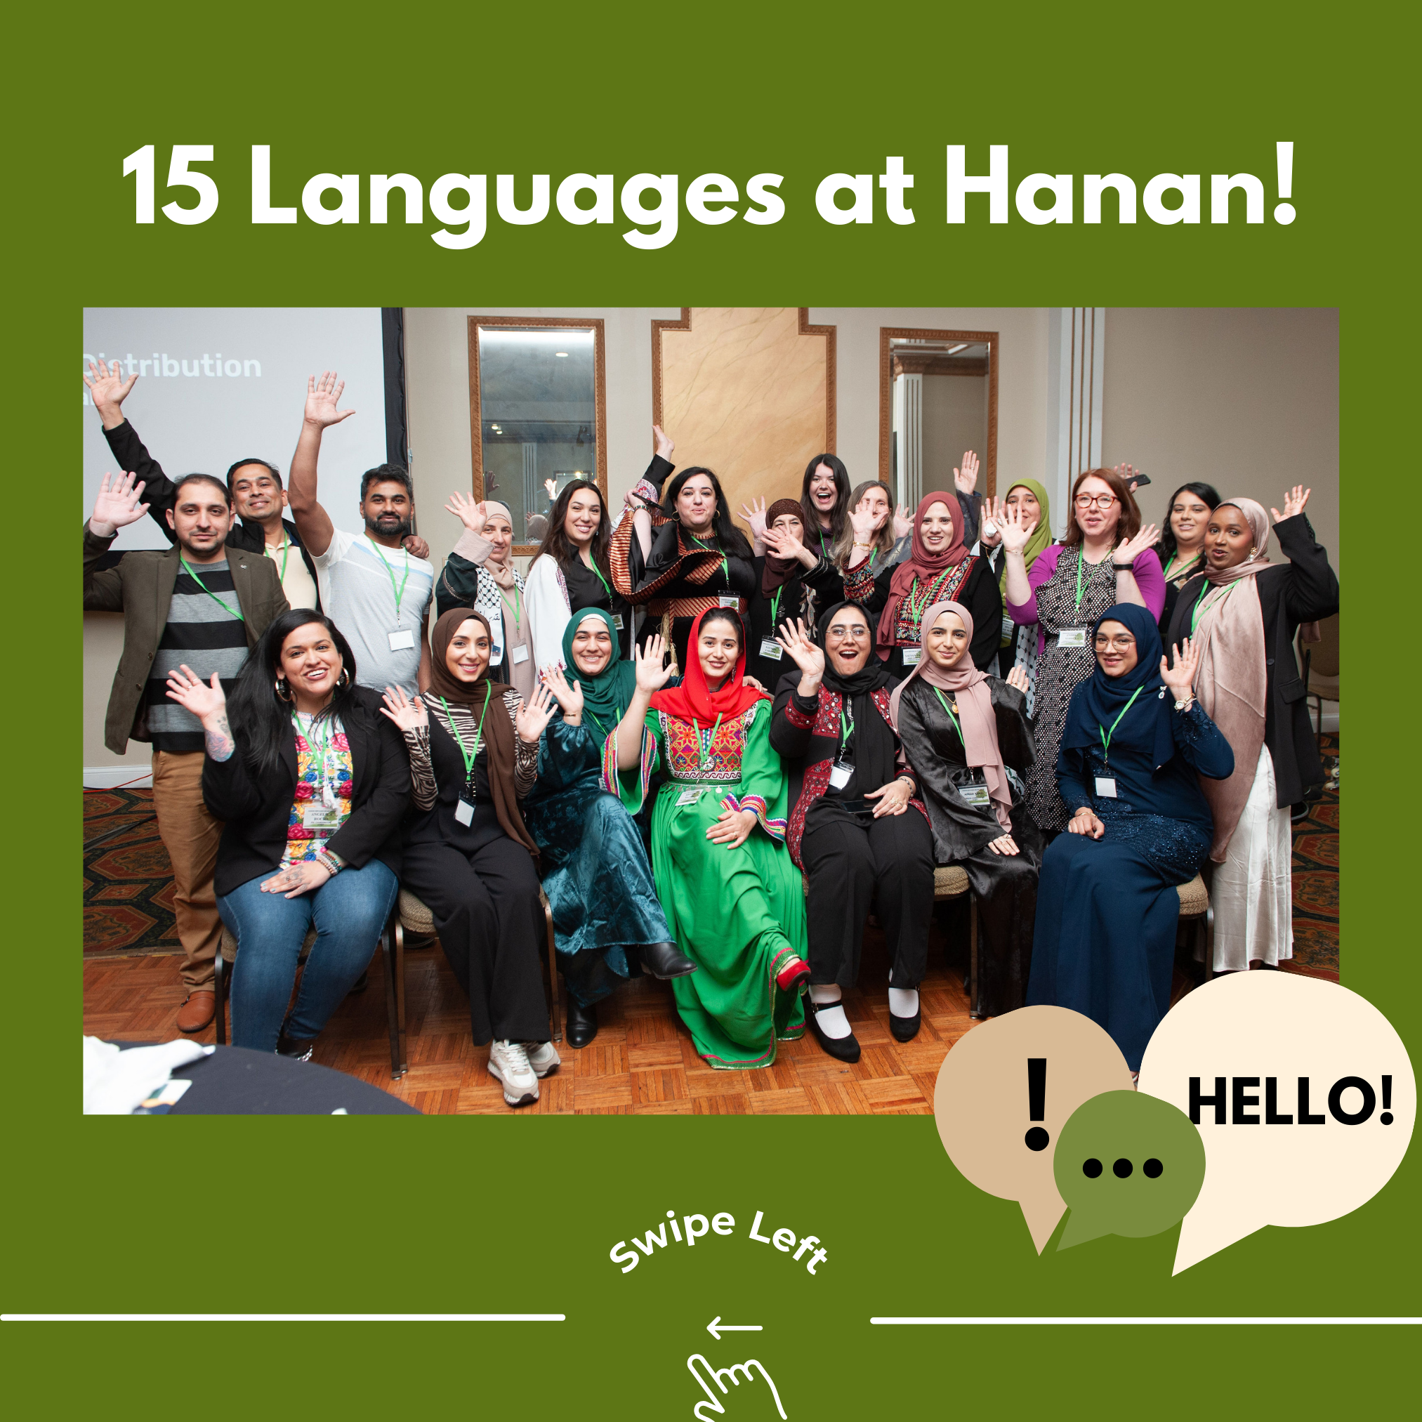

Slide 7
WHAT IS REFUGEE RESETTLEMENT?
A Resettlement Agency is a non-profit organization that cooperates with the U.S. government in a public-private partnership to assist refugees who come here through the United States Refugee Admissions Program.
During an intensive 90 day program, we secure housing, set up school and ESL enrollment, schedule health screenings, and provide employment assistance and cultural orientation .
https://www.youtube.com/watch?v=wQv1047PvBg

Slide 8
OUR
PROGRAMS
REFUGEE RESETTLEMENT
  Intensive 90-Day Reception & Placement Program, Follow-Up Assistance for up to 5 years post arrival
SOCIAL SERVICES
  Case Management, Mentorship Program, Rent Assistance, Free Clothing, Hygiene Kits & Diapers
HEALTHY LIVING PROGRAMS
  Health Fairs, Health Screenings, Maternal Health Program, Health & Wellness Classes
FOOD PROGRAMS
  Assistance Navigating FoodShare & WIC, Halal Food Boxes, Ramadan Food Box, Qurbani Meat, & Halal Turkey Giveaways
WOMEN & CHILDREN
  Group Therapy, Youth Group, Young Adult Programs, Driving Classes & On-Site Babysitting During Programming
EDUCATIONAL PROGRAMS
  ESL & ESL-at-Home Classes, Employment Workshops, Resume Building, Dr. Nasef Scholarship, Job Fairs
LEGAL PROGRAM
  Green Card Adjustments, Employment Cards, Family Reunification and more- Accredited through USCIS

Slide 9
REFUGEE POPULATIONS WE CURRENTLY SERVE
ROHINGYA*
BURMESE/KAREN
BURMESE/CHIN
SYRIAN
CONGOLESE
IRAQI
AFGHAN
SOMALIAN
PALESTINIAN
SUDANESE
VENEZUELAN
NICARAGUAN
MALI
COLUMBIAN
UKRAINIAN

Slide 10
OUR
ACHIEVEMENTS
Approved by the U.S. State Department in 2023 as a Refugee Resettlement Agency through an institutional partnership with IRC and Islamic Relief USA.
Recognized with multiple awards, including national recognition from Islamic Relief as the top resettlement agency in their network.
Successfully resettled more than 500 refugees in Wisconsin since 2023.
Accredited by USCIS as a recognized organization authorized to process legal immigration and citizenship applications.
Partnered & Funded by Milwaukee County to expand services for older refugees.
Partnered & Funded with the Wisconsin Department of Children and Families to deliver Supportive Services for Refugee Resettlement.
Provides annual scholarships to refugee and immigrant students through the Dr. Ahmad Nasef Scholarship.

Slide 11
HANAN’S
PARTNERSHIPS
Islamic Society of Milwaukee
Islamic Relief USA
Baitulmaal
MATC
Maximus
MCHC (Muslim Community Health Clinic)
Missionary Currie for Women and Children
UMOS
Aurora Walker’s Point
Network Health
Milwaukee Muslim Women’s Coalition
Hayat Pharmacy
Zena Counseling Center
Hunger Task Force
Lynden Sculpture Garden
Our Peaceful Home
SEA Literacy
PBS Wisconsin
Wisconsin Literacy
Literacy Services of Wisconsin
Layton Dental
Baby2Baby
St Elizabeth Ann Seton Church-New Berlin
Catholic Charities
Community Center for Immigrants

Slide 12
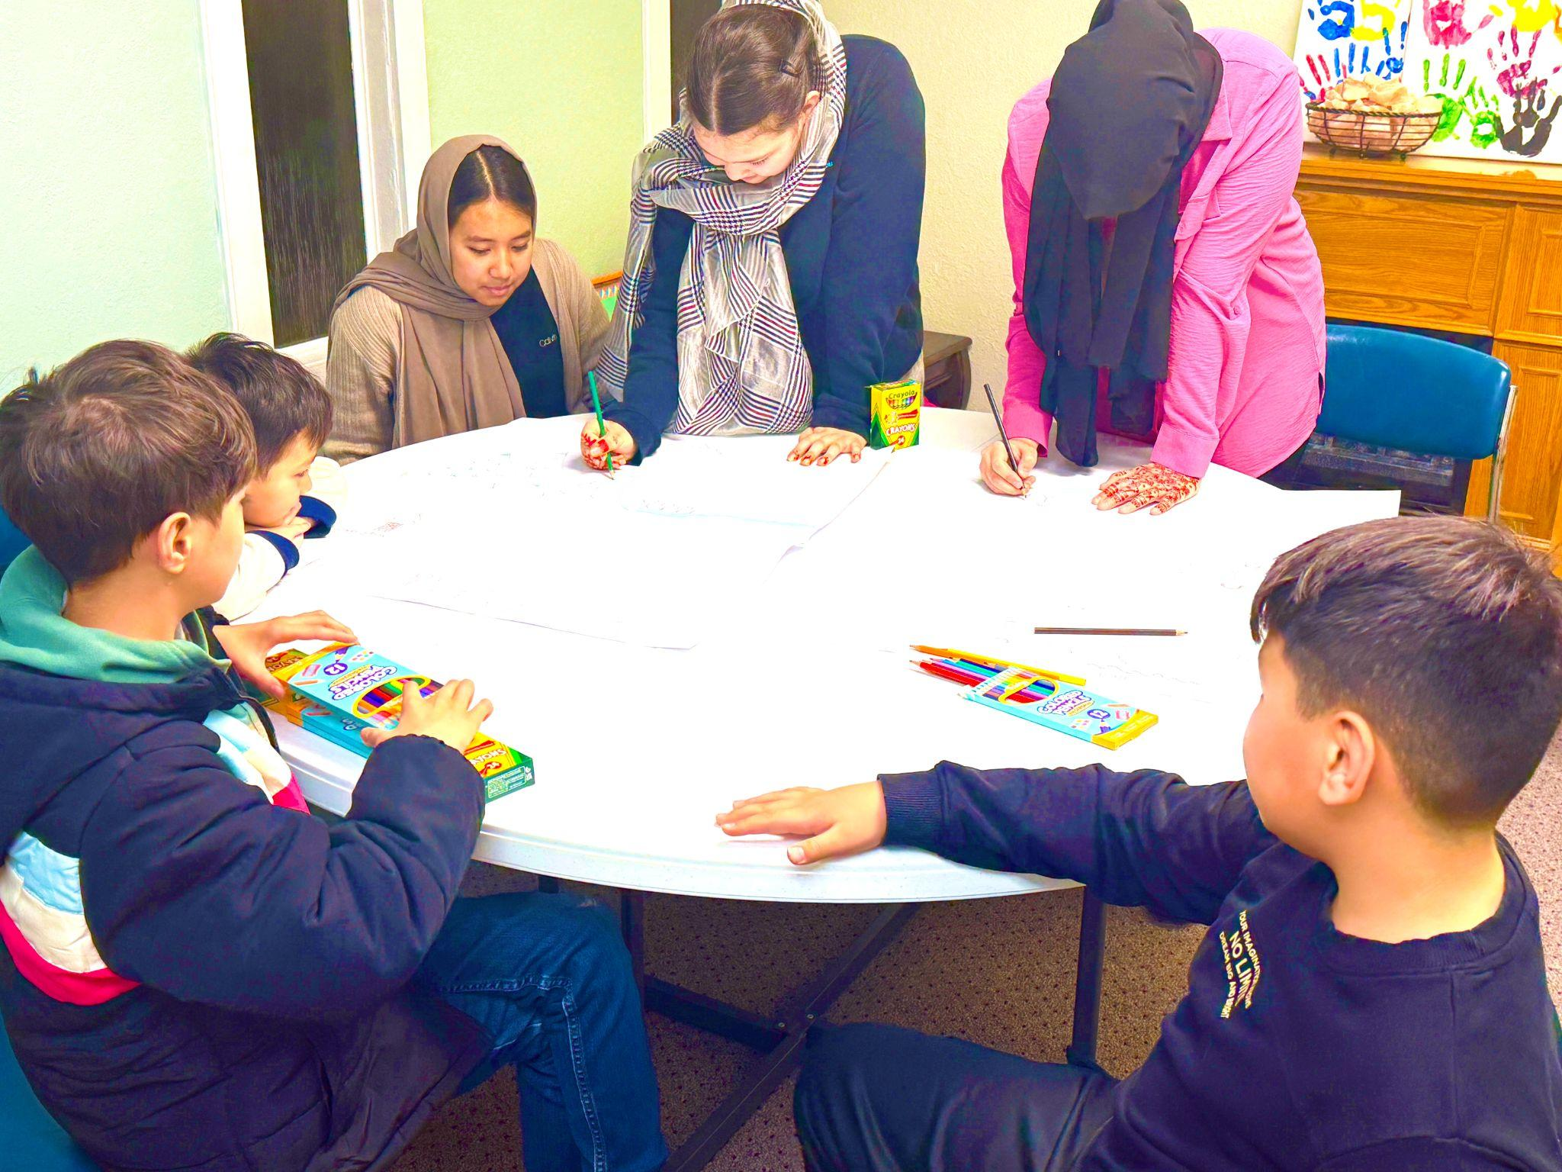
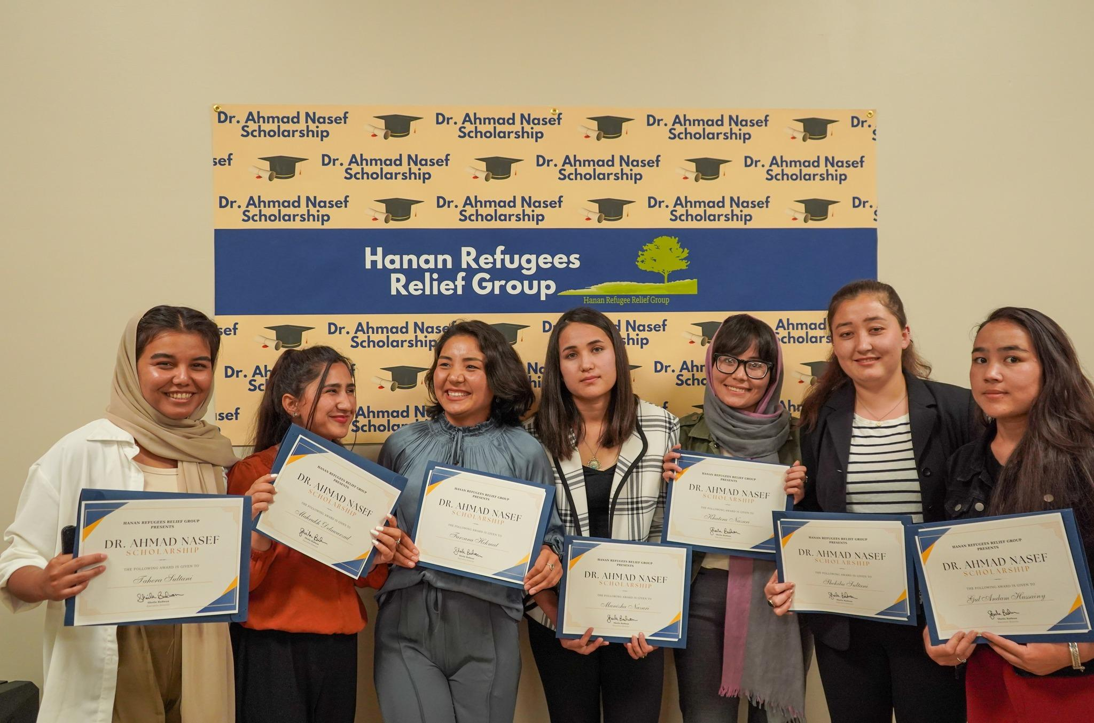
Left: Hanan’s Youth Group
Right: Dr. Nasef Scholarship Recipients 2022

Slide 13
HOW CAN YOU HELP?
Ways to Support Hanan
Donate
Your monetary contributions help sustain our programs.
Give to the Dr. Nasef Scholarship Fund to support refugee students.
Host a Drive
Collect essential items such as cleaning supplies and personal hygiene products.
Supporting Our Food Pantry with Cultural Specific Foods
Share
Spread the word by sharing our posts on Facebook, Instagram, and LinkedIn.
Forward our emails to friends or colleagues who may want to get involved.
Volunteer
Offer your time and skills to make a direct impact in the lives of refugees.
Notes:
Talk about volunteer activities - driving to our programming, setting up homes, working events, ESL at home, mentoring

Slide 14
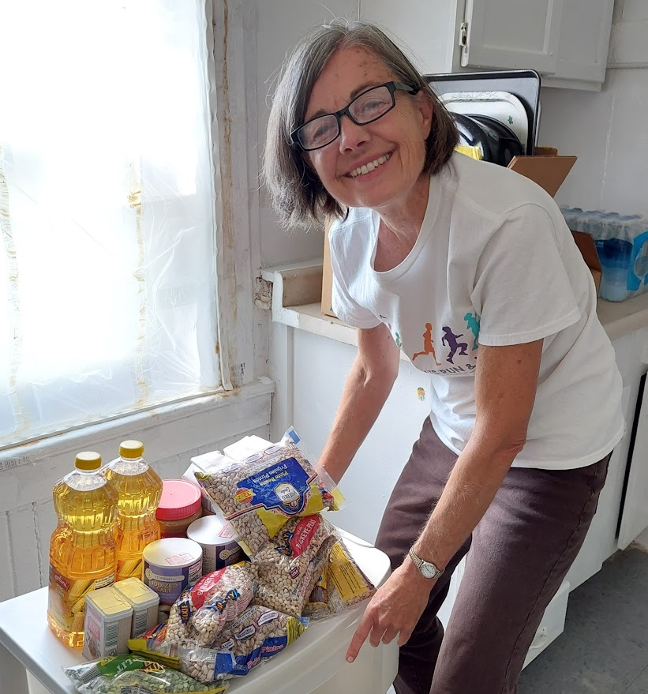
VOLUNTEERS
We began as an all-volunteer organization and volunteers remain at the core of our organization.
Hanan RRG has 100+ volunteers.
About 30 volunteers that volunteer weekly.
Over 100 volunteers that volunteer at least 2-3 times per year.
A total of over 300 volunteers annually participate in one of our programs
Began a thank you luncheon and a yearly award.
Notes:
Talk about volunteer activities - driving to our programming, setting up homes, working events, ESL at home, mentoring

Slide 15
VOLUNTEER ROLES
Provide transportation to medical appointments, youth programs, and English classes (18+)
Assist with housing setup and organizing storage
Support community events: Ramadan Food Box, Turkey Give-Away, Qurbani, Back-to-School supply drives
Mentor families or individuals to help them adapt to their new home
Tutor English in-home (18+)
Babysit during ESL and Maternal Health classes (18+)
Pack hygiene kits and organize donation drives for cleaning and household items
Teach refugees how to use public transportation (18+)
Notes:
Talk about volunteer activities - driving to our programming, setting up homes, working events, ESL at home, mentoring

Slide 16
SPECIAL EVENTS
Hanan has 5 Annual Community events each year In Milwaukee: Day of Dignity (Back to School), Ramadan Food Boxing, Halal Turkey Giveaway, Qurbani (meat), Refugee and Immigrant Health Fair.
Open to all volunteers 14 & older.
Great way to learn about Hanan’s work and get started
Notes:
Talk about volunteer activities - driving to our programming, setting up homes, working events, ESL at home, mentoring

Slide 17



Slide 18
Contact us at staff@hananrrg.org
Call us at 414-800-4168
Learn how you can get involved with Hanan
THANK YOU!

